Slide 1
Constructors in Java
Instructor : Prashant Mishra
BIAS Bhimtal

Slide 2
Constructor
In Java, a constructor is a block of codes similar to the method. It is called when an instance of the class is created. At the time of calling constructor, memory for the object is allocated in the memory.
It is a special type of method which is used to initialize the object.
Every time an object is created using the new() keyword, at least one constructor is called.
It calls a default constructor if there is no constructor available in the class. In such case, Java compiler provides a default constructor by default.
There are two types of constructors in Java: no-arg constructor, and parameterized constructor.
Note: It is called constructor because it constructs the values at the time of object creation. It is not necessary to write a constructor for a class. It is because java compiler creates a default constructor if your class doesn't have any.

Slide 3
Rules for creating Java constructor
There are two rules defined for the constructor.
Constructor name must be the same as its class name
A Constructor must have no explicit return type
A Java constructor cannot be abstract, static, final, and synchronized
Note: We can use access modifiers while declaring a constructor. It controls the object creation. In other words, we can have private, protected, public or default constructor in Java

Slide 4
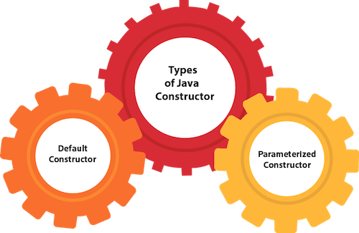
Types of Java constructors
There are two types of constructors in Java:
Default constructor (no-arg constructor)
Parameterized constructor

Slide 5
Default Constructor
A constructor is called "Default Constructor" when it doesn't have any parameter.
Syntax of default constructor:
<class_name>(){}
Example of default constructor
In this example, we are creating the no-arg constructor in the Bike class. It will be invoked at the time of object creation.
purpose of a default constructor:
The default constructor is used to provide the default values to the object like 0, null, etc., depending on the type.

Slide 6
Java Program to create and call a default constructor
class Bike1{
//creating a default constructor
Bike1(){System.out.println("Bike is created");}
//main method
public static void main(String args[]){
//calling a default constructor
Bike1 b=new Bike1();
}
}
Output:
Bike is created
Rule: If there is no constructor in a class, compiler automatically creates a default constructor.

Slide 7
Example of default constructor that displays the default values
//Let us see another example of default constructor
//which displays the default values
class Student3{
int id;
String name;
//method to display the value of id and name
void display(){System.out.println(id+" "+name);}
public static void main(String args[]){
//creating objects
Student3 s1=new Student3();
Student3 s2=new Student3();
//displaying values of the object
s1.display();
s2.display();
}
}
Output:
0 null
0 null
In the above class , you are not creating any constructor so compiler provides you a default constructor. Here 0 and null values are provided by default constructor.

Slide 8
Java Parameterized Constructor
A constructor which has a specific number of parameters is called a parameterized constructor.
Why use the parameterized constructor?
The parameterized constructor is used to provide different values to distinct objects. However, you can provide the same values also.
Example of parameterized constructor
In this example, we have created the constructor of Student class that have two parameters. We can have any number of parameters in the constructor.

Slide 9
//Java Program to demonstrate the use of the parameterized constructor.
class Student4{
int id;
String name;
//creating a parameterized constructor
Student4(int i,String n){
id = i;
name = n;
}
//method to display the values
void display(){System.out.println(id+" "+name);}
public static void main(String args[]){
//creating objects and passing values
Student4 s1 = new Student4(111,"Karan");
Student4 s2 = new Student4(222,"Aryan");
//calling method to display the values of object
s1.display();
s2.display();
}
}
Output:
111 Karan
222 Aryan

Slide 10
Difference between constructor and method in Java
Java Constructor | Java Method
A constructor is used to initialize the state of an object. | A method is used to expose the behavior of an object.
A constructor must not have a return type. | A method must have a return type.
The constructor is invoked implicitly. | The method is invoked explicitly.
The Java compiler provides a default constructor if you don't have any constructor in a class. | The method is not provided by the compiler in any case.
The constructor name must be same as the class name. | The method name may or may not be same as the class name.

Slide 11
